Slide 1
Online-Banking System
Presentation

Slide 2





About Us
Project Submitted by:
NAME | Roll No. | Registration No.
Rahul Singh | 38 | 12113266
Ranjan Alok | 40 | 12113780
Ashish Kumar | 42 | 12114307
Course Code: CSE310
Under the Guidance of
Dr. Ranjith Kumar A
Assistant Professor
School of Computer Science and Engineering
Phagwara, Punjab

Slide 3






Introduction
what is an online banking syatem ?
An online banking system is a digital platform provided by banks and financial institutions that enables their customers to perform various banking transactions over the internet. This includes activities such as account management, balance inquiries, fund transfers, bill payments, loan applications, and more.
Short history about Online Banking System.
The first internet banking application was started in U.S.A in 1996 and then, the eminent banks such as Citibank and Wells Fargo started to provide this service to their customers in 2001.

Slide 4



Importance of Online Banking Systems.
Convenience: Online banking systems allow customers to access their accounts from anywhere at any time.
Time-saving: Online banking eliminates the need to visit a physical bank branch, saving customers a significant amount of time.
Increased security: Online banking systems use advanced encryption technologies to protect customers' personal and financial information. (two-factor authentication).
Better record keeping: Online banking systems provide customers with detailed records of their transactions, including the date, time, and amount of each transaction.
Overall, online banking systems offer numerous benefits to customers.As a result, they have become an essential part of the modern banking experience.

Slide 5

Abstract
The purpose of this project is in partial fulfilment of the requirements of customer using the online banking for payment. The Design and development of this Bank Management system provides a more secured approach in managing bank customer’s information which strengthens the relationships between banks and their customers by providing the right solutions that uses a multilevel security to improve customer satisfaction. The programming language used to develop this project is. Java.
The Domain “Banking System " keeps the day by day tally record as a complete banking. It can keep the information of Account type, account opening form, Deposit, Withdrawal, and Searching the transaction, Transaction report, Individual account opening form, Group Account. The exciting part of this project is; it displays Transaction reports, Statistical Summary of Account type and Interest Information.

Slide 6



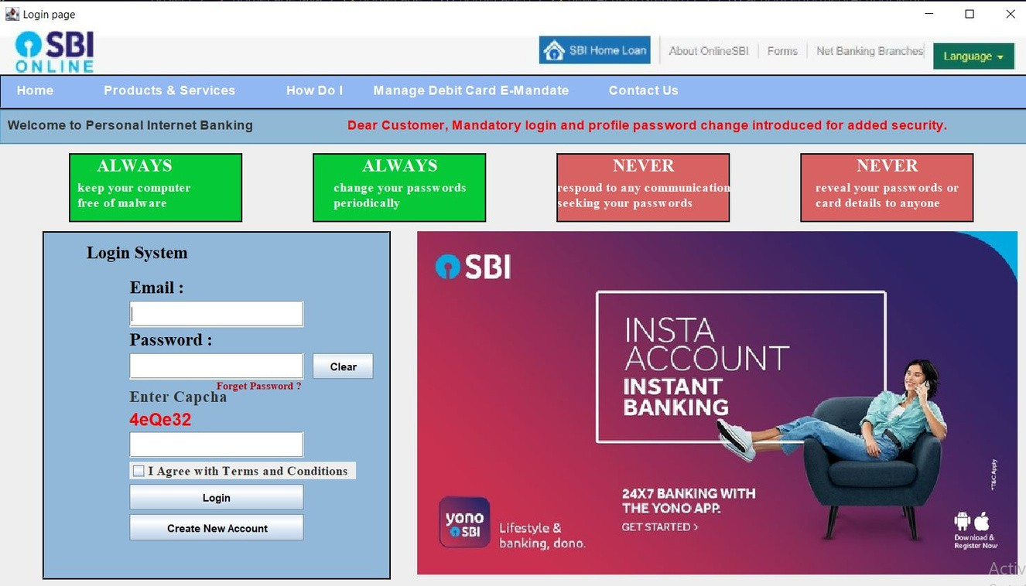

Overview
Of Modules
This Module allows user to login into the Banking Application
1. Login / Sign up
Module
The following image depicts what the login screen looks like to any user. The login screen allows registered users to login to the site to access all of the features that their account gives them access to. If they type in their username and password and click submit the users credentials are validated and if correct they are logged in.

Slide 7




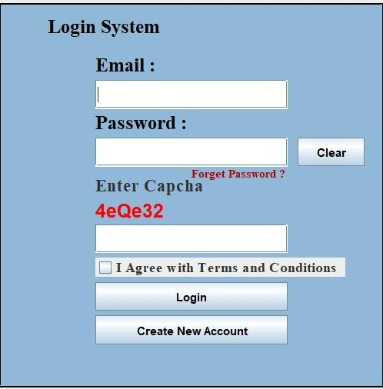
User need to add correct email and password which they have set in sign up module additionaly they must abide by the Terms and Condition of the bank.
After entering Correct Email and Password, a multicharacter Capcha is required to be filled in the page. If not done then accounting page will not show up.

Slide 8



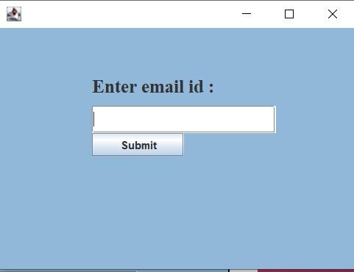
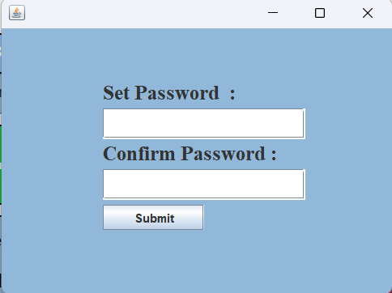


If the user has forget his/her password he need to Click on "Forget Password", on clicking it a pop window appears to reset the password of the account.
New window asks to enter registered email id and then the user can set new password to their account.

Slide 9




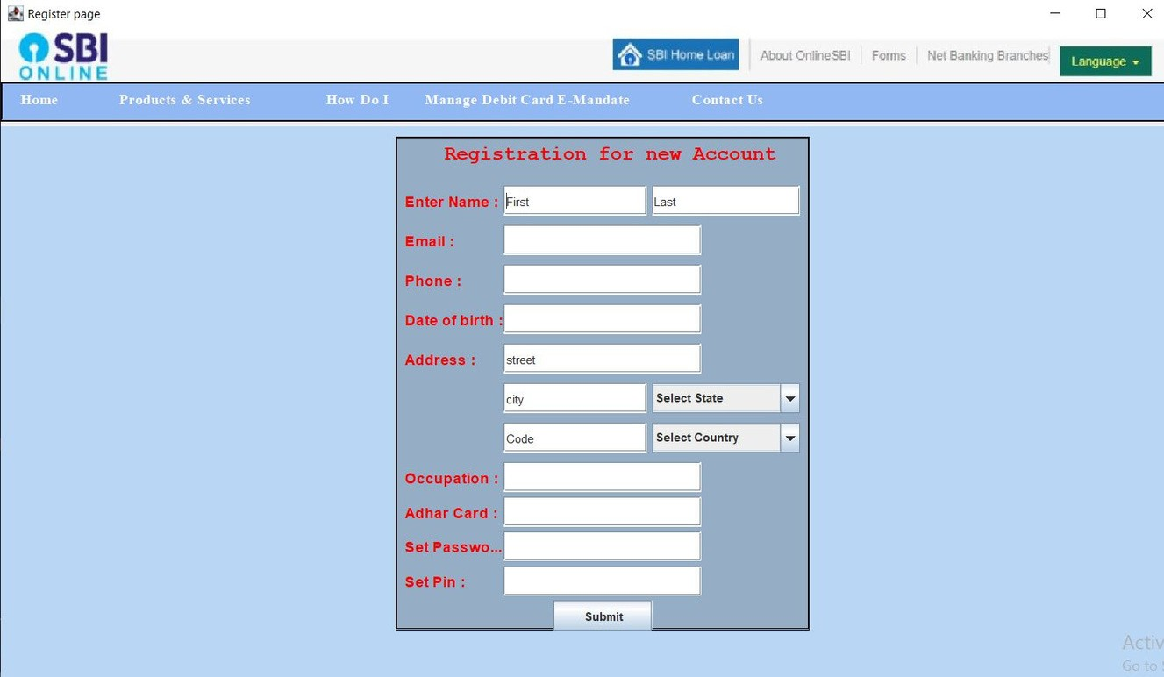

2. Register Module
If someone is new to the app then he /she can create there account from "Create new account" button present in the login module.
New user need to add their important details like name, email, Phone, DOB, address and other details mentioned in the image.
User also need to set their password and pin to enter into the account.

Slide 10


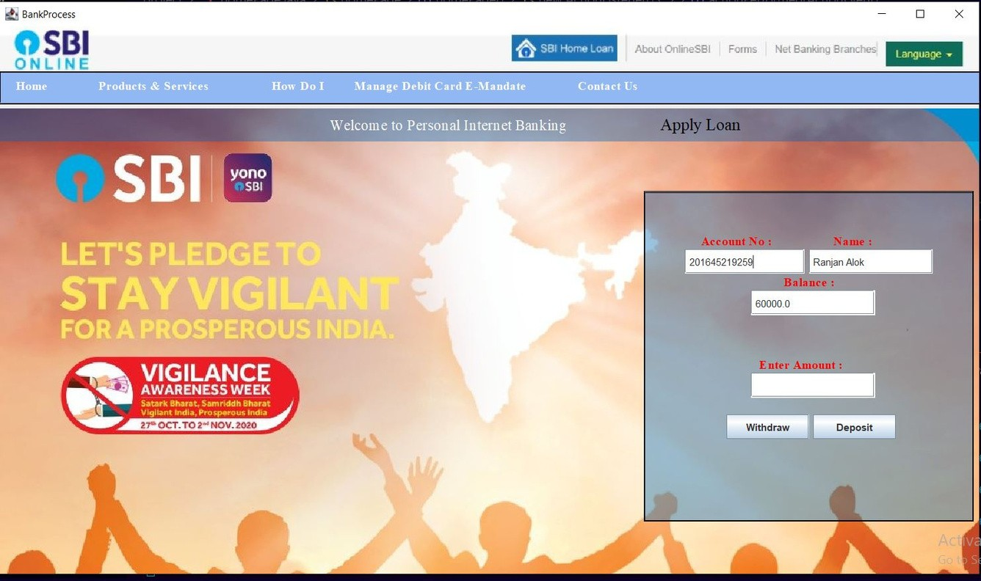


3. Transaction Module
User have to enter their account no. given from their respective banks and pin they had set before.
It displays the amount present in saving account and options of withdrawal and deposit amount.
Transction Page keeps track of money deposited
/withdraw
It also provide an option to apply for loan in the bank.

Slide 11

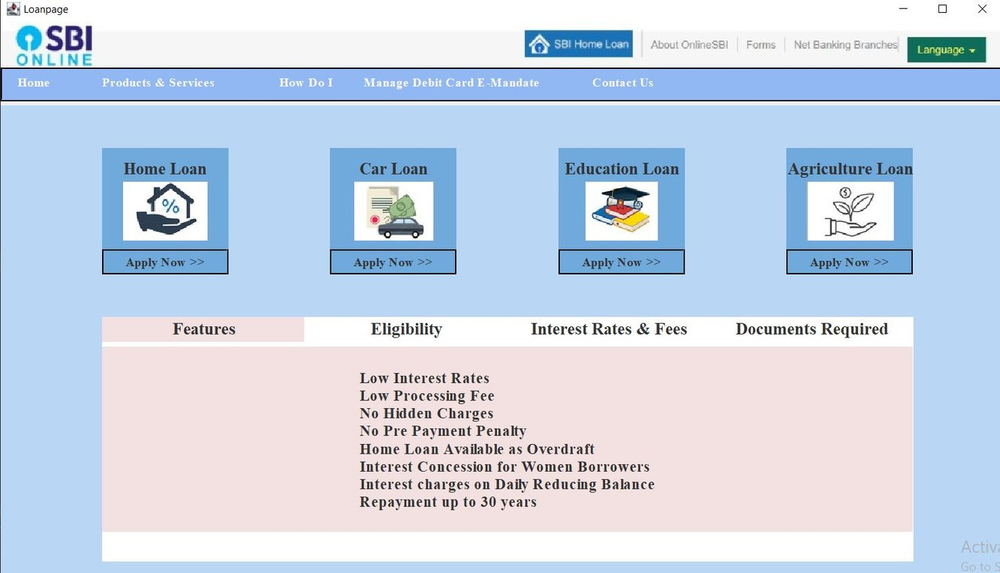


4. Loan Page Module
This page displays various loan options such as Home Loan, Car Loan, Educational Loan and others in it.
It also provides basic guidelines to the us about loan and intrest offered by the ban

Slide 12



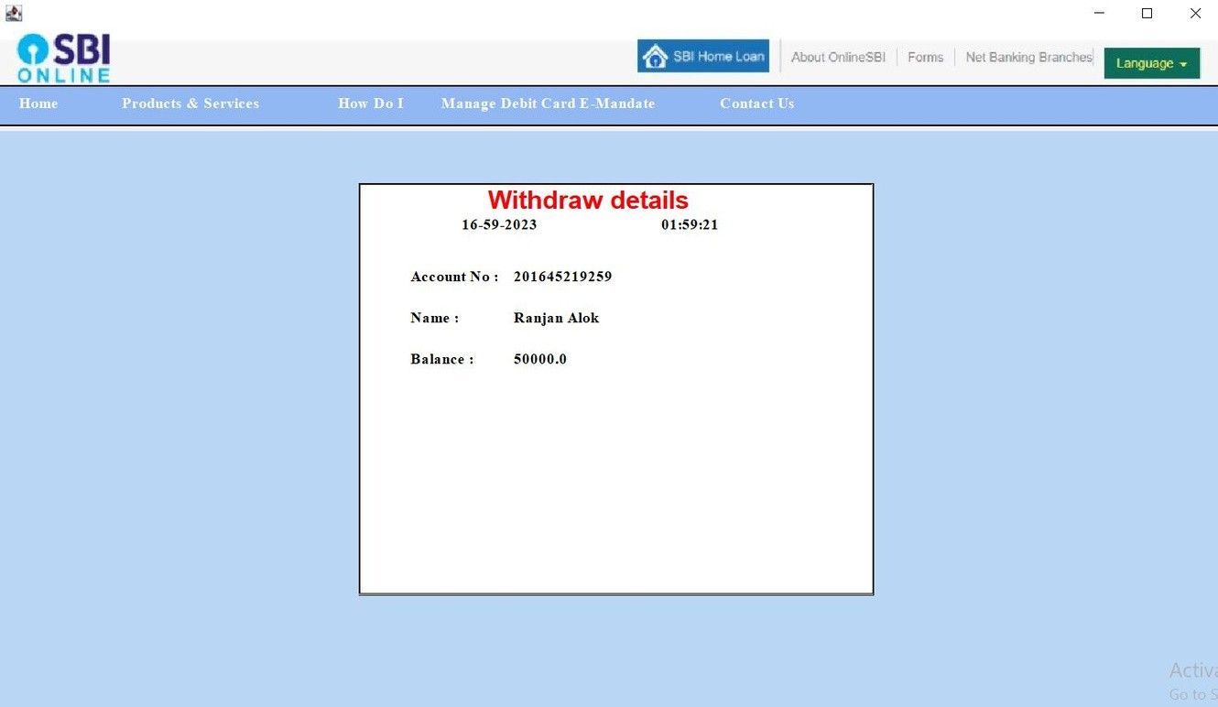

5. Receipt Module
User also have the access ^{h}to⁺ look into the history that is all the logs of transaction done through his account

Slide 13




Conclusion:
The online banking system project using Java is an essential application that benefits both the bank and its customers. Its success depends on proper planning, development, and implementation of features that meet the requirements of the stakeholders.
Online banking systems provide a convenient way for customers to access their bank accounts and perform transactions from anywhere and at any time. The use of Java programming language offers several advantages, such as platform independence, security, and scalability
Overall, the Online Banking System project using Java provides a useful solution for banks and their customers to streamline banking operations and improve customer service.

Slide 14
Thank You

